Slide 1

GENERATIVE AI
TNSDC-GENERATIVE AI
RITHIKA.G
III YR CSE
311521104040

Slide 2
GENERATIVE AI
PROJECT TITLE:
SENTIMENT ANALYSIS

Slide 3
Introduction
Problem statement
Project overview
Agenda
End users
Value Proposition
Solution
Modelling
Results

Slide 4

Add Company Name
PROBLEM STATEMENT
. This project aims to design and implement a scalable machine learning or deep learning model capable of accurately categorizing social media content into positive, negative, or neutral sentiments. By integrating with popular social media APIs, the system will process and analyze data in real-time, providing actionable insights for informed decision-making and contributing to advancements in natural language processing research.
Back to Agenda Page

Slide 5
PROJECT OVERVIEW
Data Collection: Gather text data from various sources like social media, customer reviews, or news articles.
Preprocessing: Clean, tokenize, and normalize the text data, removing noise, punctuation, and stopwords.
Model Selection: Choose an appropriate sentiment analysis model, such as machine learning classifiers or deep learning architectures.
Training and Evaluation: Train the selected model on labeled data and evaluate its performance using metrics like accuracy, precision, recall, and F1 score.
Deployment and Monitoring: Deploy the trained model for real-time sentiment analysis, continuously monitoring its performance and updating as needed.

Slide 6
Businesses: Utilize sentiment analysis to understand customer feedback and improve products/services.
Marketing Professionals: Monitor brand sentiment and consumer behavior to optimize marketing strategies.
Customer Support Teams: Categorize and prioritize customer inquiries based on sentiment for efficient resolution.
Financial Institutions: Analyze market sentiment to inform investment decisions and manage risks effectively.
Government Agencies: Monitor public sentiment to gauge opinion on policies and improve public services.
Values
Back to Agenda Page

Slide 7
VALUE PROPOSITION
Actionable Insights: Sentiment analysis transforms unstructured text data into valuable insights, allowing businesses to understand customer sentiments and preferences, identify emerging trends, and adapt strategies accordingly for improved decision-making and enhanced customer satisfaction.
Brand Reputation Management: By monitoring sentiment across various channels, businesses can proactively manage their brand reputation by promptly addressing negative feedback or emerging issues, thereby fostering trust, loyalty, and positive brand perception among customers.

Slide 8
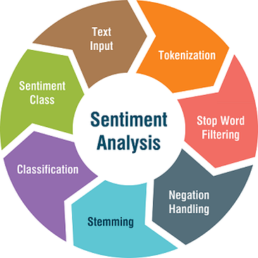
SOLUTION
To develop a sentiment analysis solution, begin by gathering a labeled dataset and preprocessing the text data to remove noise and tokenize it.
Extract numerical features using techniques like Bag-of-Words or word embeddings. Select an appropriate model such as SVM, Naive Bayes, or deep learning architectures like RNNs or Transformers, and train it on your dataset.
Evaluate the model's performance using metrics like accuracy and F1-score, and deploy it into production for real-time sentiment analysis. Continuously monitor and maintain the model to ensure its effectiveness over time.

Slide 9
GENERATIVE AI
SENTIMENT ANALYSIS
RESULTS
The the result for the sentiment analysis will be decided based on the sentence give by the user.If the sentence is positive then the result will be positive .If the result is negative then negative will be displayed as output.if nothing then zero will be displayed .This results are very useful during the text classification as it could tell the negative words so it could be removed by stop words.

Slide 10

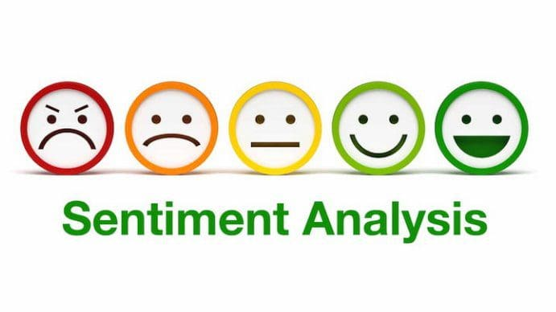
OUTPUT:

Slide 11
THANK YOU

